Slide 1
TITLE
Developing and Optimizing Convolutional Neural Networks for Traffic Sign Recognition: A Comparative Study Using Transfer Learning and Model Architecture Tuning on the Indian Traffic Sign Recognition Benchmark (ITSRB) Dataset

Slide 2
Problem Statement
The growing complexity of Indian road traffic and the increasing reliance on autonomous driving systems highlight the critical need for accurate and reliable traffic sign detection and recognition.
Traditional computer vision techniques have struggled to achieve optimal performance due to the inherent variability's in real-world traffic scenarios, such as changes in lighting, weather, and occlusion. With the rise of deep learning, particularly Convolutional Neural Networks (CNNs), there has been significant improvement in traffic sign recognition, but challenges remain in achieving consistent and accurate detection, localization, and classification in diverse environments.
This project addresses the problem of enhancing traffic sign recognition systems by developing a CNN-based approach and by using Pertained models and MLops. Despite recent advances, achieving near-perfect recognition accuracy remains a challenge, particularly in the context of complex, real-world driving environments. The proposed solution aims to overcome these limitations and contribute to the broader goal of improving road safety, supporting autonomous vehicle navigation, and aiding drivers, including those with disabilities, through more effective recognition and interpretation of traffic signs

Slide 3
Data set info
Indian traffic sign dataset was used to work on a Traffic sign detection and recognition system.
The dataset can be used for any Traffic Sign project based on Image Classification.
The images in the dataset are of dimension 32 32 3.
The dataset was created by an image of each class taken from government website and further image scaling was performed.
The Images are Preprocessed, Grayscaled and Standardized Lighting.

Slide 4
Data Cleaning

Slide 5
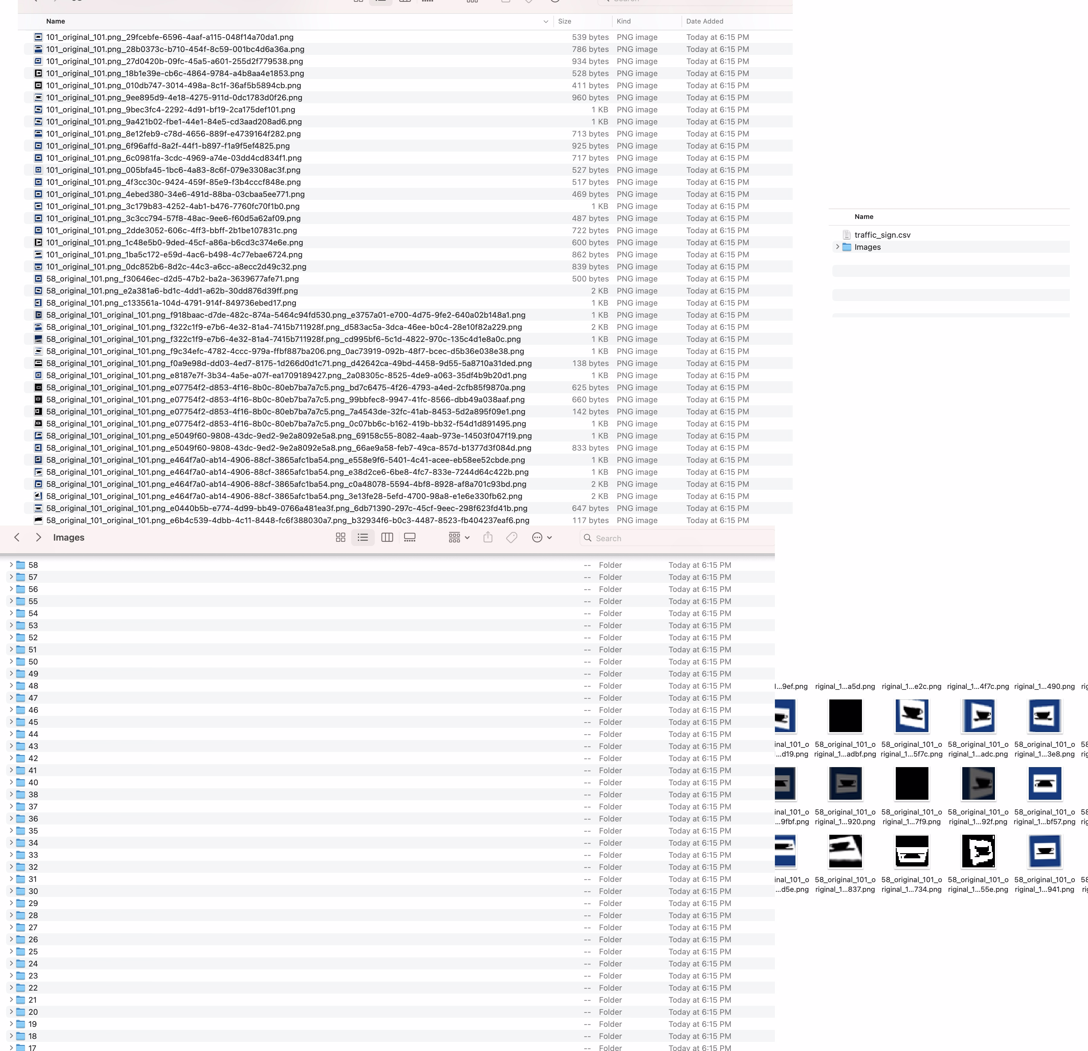
Data before cleaning and organising

Slide 6
Data after cleaning and organisation
Modifications made :
1. Deleted all the images that were unusable.
2. Deleted repeated classes and merged the images from these classes into a single class and relabeled these images.
3. The images in each class was mislabeled and there was no test dataset provided, wrote a code for labeling and segregation of data into test and training dataset.

Slide 7
ML Methodologies used
CNNs (Convolutional Neural Networks): Utilized for traffic sign recognition, applying layers such as Conv2D for feature extraction, MaxPool2D for dimensionality reduction, and Batch Normalization to stabilize learning and improve convergence on complex traffic sign data.
Reflective Padding: Custom layer that ensures better edge information preservation, crucial for accurate recognition of traffic signs, especially when images have clear boundaries or fine details.
Swish Activation: Chosen for its smooth gradient flow, aiding in more efficient learning during training and improving recognition accuracy, especially on diverse real-world traffic sign data.
Regularization Techniques: Dropout (50%) and Batch Normalization are employed to prevent overfitting and enhance the model's ability to generalize to new, unseen traffic signs.
He Normal Initialization: Optimizes the weight initialization strategy, ensuring stable training and faster convergence, which is vital when dealing with large datasets of traffic signs.
The project uses pre-trained models for enhanced feature extraction and faster convergence:
InceptionV3: Known for its ability to extract fine-grained features with its complex architecture.
MobileNetV2: Lightweight model offering efficiency with a focus on speed, suitable for mobile or resource-constrained devices.
VGG19: Deep model with 19 layers, providing robust feature extraction through simpler convolutions.

Slide 8
Metrics Used for Model Evaluation
1. ROC curve: Graph between TPR and FPR
2. Confusion Matrix.

Slide 9
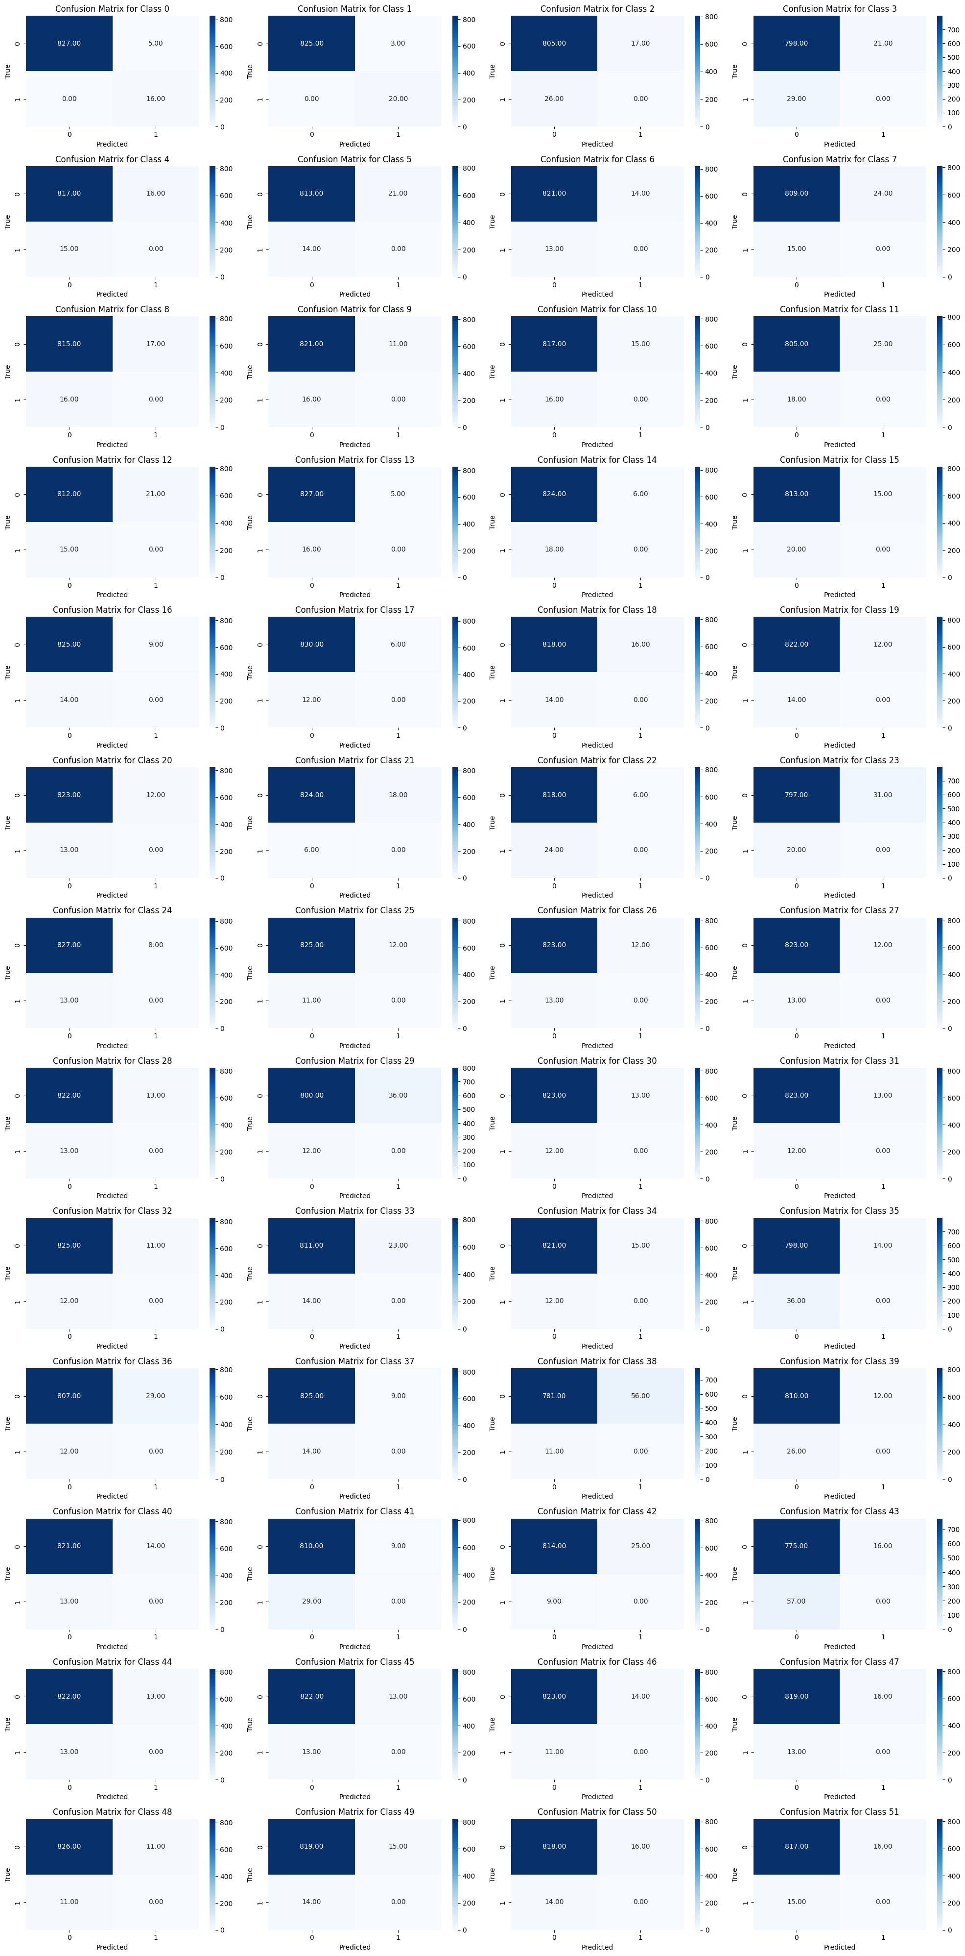
Confusion matrix for each class

Slide 10
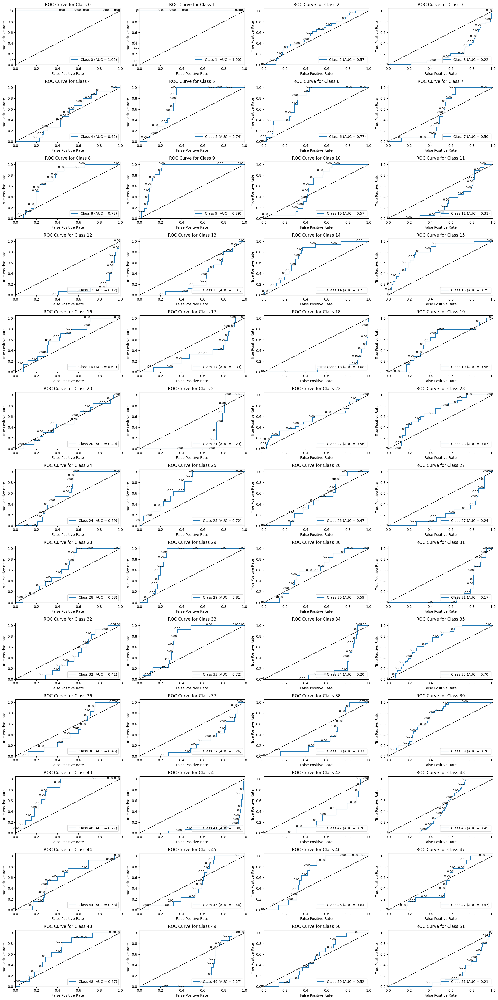
ROC for CNN model

Slide 11
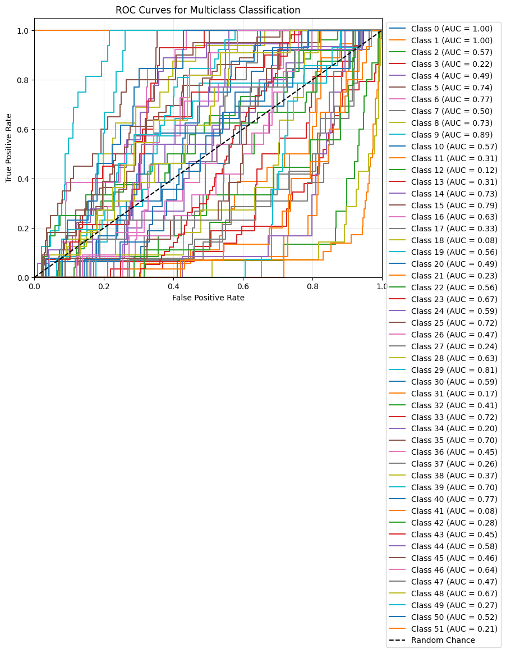
Combined ROC for all Classes

